Slide 1
Form Object, Methods And Properties

Slide 2
Document Object Model - DOM
Every web page resides inside a browser window which can be considered as an object.
A Document object represents the HTML document that is displayed in that window. The Document object has various properties that refer to other objects which allow access to and modification of document content.
The way a document content is accessed and modified is called the Document Object Model, or DOM. The Objects are organized in a hierarchy. This hierarchical structure applies to the organization of objects in a Web document.
Window object − Top of the hierarchy. It is the outmost element of the object hierarchy.
Document object − Each HTML document that gets loaded into a window becomes a document object. The document contains the contents of the page.
Form object − Everything enclosed in the <form>...</form> tags sets the form object.
Form control elements − The form object contains all the elements defined for that object such as text fields, buttons, radio buttons, and checkboxes.

Slide 3
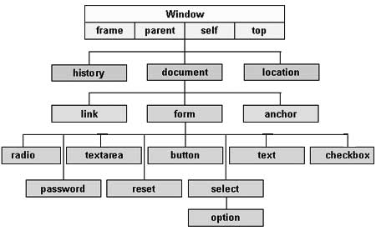
Browser Object Hierarcy

Slide 4
Form Object
Create a form in an HTML document using the <form> and </form> tags
automatically create a form object with properties, methods and events that relate to the form itself and to the individual elements within the form

Slide 5
Form properties
1. name - The name of the form, as defined in the HTML <form> tag when the form is created
Example:
<form name="myForm">
alert(document.forms[2].name);
It gives 3rd form name in the given document
Forms - An array containing all the forms (if any) in the document.
It accepts an index number in the following way:
forms[index-number]
where index-number is the number of a particular form.
Forms are automatically numbered from 0, starting at the beginning of the document, so the first form in an HTML document will always have the index-number 0.

Slide 6
Form Properties
2. Method - The method used to submit the information in the form, as defined in the HTML <form> tag when the form is created, for example:
<form method="POST">
The method property can be set either to POST or GET

Slide 7
Form Properties
action - The action to be taken when the form is submitted, as defined in the HTML <form> tag when the form is created,
Example:
<form action="mailto:sales@bigco.com">
<form action=“first.html">
The action property specifies either the URL to which the form data should be sent (e.g., for processing by a CGI script) or mailto: followed by an email address to which the data should be sent (for manual processing by the recipient).

Slide 8
Form Properties
4. length - The number of elements (text-boxes, buttons, etc.) in the form.
Example:
alert(document.forms[2].length);
will display the number of elements in this form

Slide 9
Form Properties
5. elements - An array of all the elements in the form. Individual elements are referenced by index-number.
Elements are automatically numbered from 0, starting at the beginning of the form, so the first element in a form will always have the index-number 0.
Example:
alert(document.forms[2].elements[0].name);
will display the name of the first element in this form,

Slide 10
Form Methods
submit() - Submits the form data to the destination specified in the action attribute using the method specified in the method attribute.
As such it performs exactly the same function as a standard 'submit' button, but it allows the programmer greater flexibility.

Slide 11
Difference between GET and POST method
BASIS FOR COMPARISON | GET | POST
Parameters are placed inside | URI | Body
Purpose | Retrieval of documents | Updation of data
Query results | Capable of being bookmarked. | Cannot be bookmarked.
Security | Vulnerable, as present in plaintext | Safer than GET method
Form data type constraints | Only ASCII characters are permitted. | No constraints, even binary data is permitted.
Form data length | Should be kept as minimum as possible. | Could lie in any range.
Visibility | Can be seen by anyone. | Doesn't display variables in URL.
Variable size | Up to 2000 character. | Up to 8 Mb
Caching | Method data can be cached. | Does not cache the data.

Slide 12
Form Event
onSubmit - Message sent each time a form is submitted.
Can be used to trigger actions (e.g., calling a function). Usually placed within the <form> tags,
Example:
<form name=“form1” onSubmit="displayFarewell()">
would cause the function displayFarewell() to execute automatically every time the form is submitted.

Slide 13
Form Elements - Text-boxes and text-areas
Properties -
Name - The name of the text-box or text-area, as defined in the HTML <input> tag when the form is created,
Example:
<input type=text name=“text”>
The name property of a text-box or other form element can be accessed using JavaScript in the manner shown under the section on document.length, above.

Slide 14
Form Elements - Text-boxes and text-areas cont..
2. Value - Whatever is typed-into a text-box by the user. For example, here is a simple text-box:
This text-box is named textBox1. Therefore, we can obtain any text typed into it using the following line of code:
alert(document.forms[2].textBox1.value);

Slide 15
Form Elements - Text-boxes and text-areas
Events :
onFocus - Event signal generated when a user clicks in a text-box or text-area.
Example, here is a simple text-box:
This text-box was declared using the following HTML code:
<input type=text name="textBox2" onFocus="alertOnFocus()">
The function called alertOnFocus() displays an alert box, so clicking in the text-box above should trigger the function and cause the alert to appear.

Slide 16
Form Elements - Text-boxes and text-areas Cont…
onBlur - Event signal generated when a user clicks outside a text-box or text-area having previously clicked inside it.
For example, here is a simple text-box:
<input type=text name="textBox3" onBlur="alertOnBlur()">
The function called alertOnBlur() displays an alert box, so clicking in the text-box above and then clicking outside it should trigger the function and cause the alert to appear.

Slide 17
Form Elements - Buttons, Radio-buttons and Checkboxes Properties
Name - The name of the button, radio-button or checkbox, as defined in the HTML <input> tag when the form is created,
Example:
<input type=button name="button1">
Value - The value given to the button when it is created.
On standard buttons the value is displayed as a label.
On radio-buttons and check-boxes the value is not displayed.
Example, here is a button:
This button is named button1 and has the value Original value, original label. We can change the value of the button, and hence it's label, using the following code:
document.forms[2].button1.value = "New value, new label";

Slide 18
Form Elements - Buttons, Radio-buttons and Checkboxes Properties Cont…
Checked - This property - which is used with radio-buttons and check-boxes but not standard buttons - indicates whether or not the button has been selected by the user.
Example, here is a checkbox:
This checkbox is named checkbox 1. We can determine whether it has been selected or not using the following code:
if (document.forms[2].checkbox1.checked == true) { alert("Checked"); } else { alert("Not checked"); }

Slide 19
Form Elements - Buttons, Radio-buttons and Checkboxes Methods
1. focus() - Give the button focus (i.e., make it the default button that will be activated if the return key is pressed). For example, here is a button that displays an alert when clicked:
This button is named button2 and has the value Hello. We can give it focus using the following code:
document.forms[2].button2.focus();
2. blur() - Removes focus from a button. For example, the code:
document.forms[2].button2.blur();
will remove the focus (indicated by the dotted line) from the button above. Click here to see this code in operation.
3. click() - Simulates the effect of clicking the button. For example, below is a button that has the following code:
document.forms[2].button2.click();

Slide 20
Form Elements - Buttons, Radio-buttons and Checkboxes Events
1. onClick - Signal sent when the button is clicked. Can be used to call a function.
For example:
This button was declared using the following code:
<input type=button name="button3" value="Click Here" onClick="alert('onClick event received')">
The code onClick="alert('onClick event received')" will cause an alert dialog box to appear whenever the button is pressed.

Slide 21
Form Elements - Buttons, Radio-buttons and Checkboxes Events Cont..
2. onFocus - Signal sent when the button receives focus (i.e., when it becomes the default button, the one that is activated by pressing the RETURN key).
For example:
This button was declared using the following code:
<input type=button name="button4" value="Click Here" onFocus="alert('This button is now the default')">
The first time you click the button it will gain focus, and the alert will appear.

Slide 22
Form Elements - Buttons, Radio-buttons and Checkboxes Events
3. onBlur - Signal sent when the button loses focus.
For example:
This button was declared using the following code:
<input type=button name="button5" value="Click Here" onBlur="alert('This button is no longer the default')">
Clicking the button will not cause the alert to appear because it will only give the button focus. However, if you remove focus from the button (e.g., by clicking somewhere else on the document) the alert will appear.

Slide 23
The Select Object
Selection-boxes behave in a very similar fashion to radio-buttons: they present several options, of which only one can be selected at a time. They also have a similar set of properties, methods and events.
To create selectionbox
<select name=‘name'>
<option name=‘option1'> displayvalue</option>
<option name=‘option2'> displayvalue</option>
. . .
<option name=‘optionN'> displayvalue</option>
</select>
that selection-boxes don't have a checked property. Instead, to find out which option has been selected, you must use the SelectedIndex property.
SelectedIndex - Returns an integer indicating which of a group of options has been selected by the user.
For example:
alert(document.forms[2].selectBox1.selectedIndex);

Slide 24
Changing the elements based on a value selected by user
Create 2 textfields – fname and lname and a function SetEmail() – seting email address as first letter of fname and lname @mycompany.com
Using onchange event of both text fields

Slide 25
<html>
<body>
<form name="contact">
<input type="text" name="fname" onchange="setEmail()">
<input type="text" name="lname" onchange="setEmail()">
<input type="text" name="Email" >
<input type="submit" name="submit" value = "Submit">
<input type="reset" name="reset" value = "Reset">
</form>
</body>
</html>

Slide 26
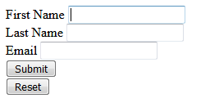

Slide 27
<script language="javascript" type="text/javascript">
function setEmail()
{
if((document.forms.contact.fname.value != "") && (document.forms.contact.lname.value != ""))
{
document.forms.contact.Email.value = document.forms.contact.fname.value.charAt(0) + document.forms.contact.lname.value + '@mycompany.com'
}
}
</script>

Slide 28
Changing option list dynamically
Create 2 radio buttons – Cadburry and Icecream
When one radio button selected other should be deselected automatically, So both radio buttons has same name attribute.
When any one radio button is selected respective flavors will be displayed in the option List using onclick event of radio button

Slide 29
<html>
<body>
<form name="contact">
<select name="optionlist" size=2>
<option value=1> "Dairy Milk"
<option value=2> "Kitkat"
</select><br/>
<input type=radio name="flavors" checked=true value=1 onclick="resetoption(this.value)"> cadburry
<input type=radio name="flavors" value=2 onclick="resetoption(this.value)"> Icecream<br/>
<input type="submit" name="submit" value = "Submit"><br/>
<input type="reset" name="reset" value = "Reset">
</form>
</body>
</html>

Slide 30
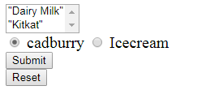

Slide 31
<script>
function resetoption(val)
{
if(val == 1)
{
document.forms.contact.optionlist[0].text = "Dairy Milk"
document.forms.contact.optionlist[0].value = 1
document.forms.contact.optionlist[1].text = "Kitkat"
document.forms.contact.optionlist[1].value = 2
}
else
{
document.forms.contact.optionlist[0].text = "Vanilla"
document.forms.contact.optionlist[0].value = 1
document.forms.contact.optionlist[1].text = "Mango"
document.forms.contact.optionlist[1].value = 2
}
}
</script>

Slide 32
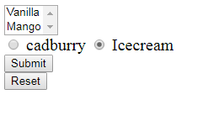

Slide 33
Evaluating Checkbox Selections
Checkbox is used to enable user to select one or more items from set known items.
Create checkboxes with different levels of education. Selexted checkboxes will displayed in alert dialogbox.

Slide 34
<html>
<body>
<form name="contact">
<input type=checkbox name="HS" value="HS"> High School<br />
<input type=checkbox name="BD" value="BD"> Bachelor's Degree<br />
<input type=checkbox name="MD" value="MD"> Master Degree<br />
<input type=checkbox name="DD" value="DD"> Doctorate Degree<br />
<input type=submit value="Process" onclick="Education()">
</form>
</body>
</html>

Slide 35
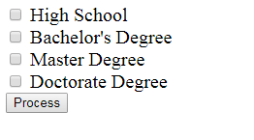

Slide 36
<head>
<script>
function Education()
{
var selection = "Your Selection is : ";
with (document.forms.contact) {
if(HS.checked==true) {
selection += "High School ";
}
if(BD.checked==true) {
selection += "Bachlor's Degree ";
}
<head>
<script>
if(MD.checked==true) {
selection += "Master Degree ";
}
if(DD.checked==true) {
selection += "Doctorate Degree ";
}
}
alert(selection)
}
</script>
</head>

Slide 37
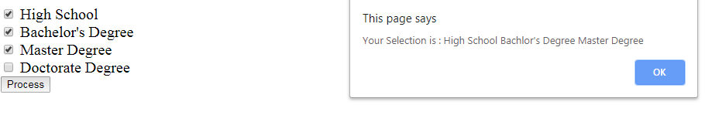

Slide 38
Changing the Label Dynamically
<form name="contact">
<select name="optionlist" size=2>
<option value=1> "Dairy Milk"
<option value=2> "Kitkat"
</select><br/>
<input type=“button" name="SwitchButton" value = "Cadburry" onclick="resetoption(this.value)">
</form>

Slide 39
<script>
function resetoption(val){
if(val == "Cadburry“){
document.forms.contact.SwitchButton.value = "Icecream"
document.forms.contact.optionlist[0].text = "Dairy Milk"
document.forms.contact.optionlist[0].value = 1
document.forms.contact.optionlist[1].text = "Kitkat"
document.forms.contact.optionlist[1].value = 2
}
else{
document.forms.contact.SwitchButton.value = "Cadburry"
document.forms.contact.optionlist[0].text = "Vanilla"
document.forms.contact.optionlist[0].value = 1
document.forms.contact.optionlist[1].text = "Mango"
document.forms.contact.optionlist[1].value = 2
}
}
</script>

Slide 40

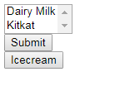
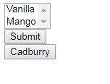

Slide 41
Disabling Element and Read Only
Element.disabled = true
Element.readonly = true

Slide 42
Intrinsic Functions
Javascript has special set of functions called intrinsic functions that mimic actions of the submit button and reset button of the form.
You need not to define intrinsic functions manually. Javascript does that for you.
You can call them in the same way as user defined functions
Intrinsic function for form submit and reset button
submit()
reset()

Slide 43
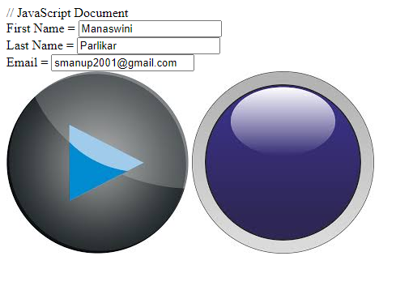
<form name='contact' action='prog1.html'>
First Name = <input type=text name='fname' ><br/>
Last Name = <input type=text name='lname' ><br/>
Email = <input type=text name='email' ><br/>
<img src='img1.jpg' onclick='submit()'>
<img src='img2.jpg' onclick='reset()'>
</form>

Slide 44
Attributes -Textfield
Sr.No | Attribute & Description
1 | type Indicates the type of input control and for text input control it will be set to text.
2 | name Used to give a name to the control which is sent to the server to be recognized and get the value.
3 | value This can be used to provide an initial value inside the control.
4 | size Allows to specify the width of the text-input control in terms of characters.
5 | maxlength Allows to specify the maximum number of characters a user can enter into the text box.

Slide 45
Attribute - Password
Sr.No | Attribute & Description
1 | type Indicates the type of input control and for password input control it will be set to password.
2 | name Used to give a name to the control which is sent to the server to be recognized and get the value.
3 | value This can be used to provide an initial value inside the control.
4 | size Allows to specify the width of the text-input control in terms of characters.
5 | maxlength Allows to specify the maximum number of characters a user can enter into the text box.

Slide 46
Attributes - TextArea
Sr.No | Attribute & Description
1 | name Used to give a name to the control which is sent to the server to be recognized and get the value.
2 | rows Indicates the number of rows of text area box.
3 | cols Indicates the number of columns of text area box

Slide 47
Attributes - Checkbox
Sr.No | Attribute & Description
1 | type Indicates the type of input control and for checkbox input control it will be set to checkbox..
2 | name Used to give a name to the control which is sent to the server to be recognized and get the value.
3 | value The value that will be used if the checkbox is selected.
4 | checked Set to checked if you want to select it by default.

Slide 48
Attributes - Radiobutton
Sr.No | Attribute & Description
1 | type Indicates the type of input control and for checkbox input control it will be set to radio.
2 | name Used to give a name to the control which is sent to the server to be recognized and get the value.
3 | value The value that will be used if the radio box is selected.
4 | checked Set to checked if you want to select it by default.

Slide 49
Attributes - select
Sr.No | Attribute & Description
1 | name Used to give a name to the control which is sent to the server to be recognized and get the value.
2 | size This can be used to present a scrolling list box.
3 | multiple If set to "multiple" then allows a user to select multiple items from the menu.

Slide 50
Attribute - option
Sr.No | Attribute & Description
1 | value The value that will be used if an option in the select box box is selected.
2 | selected Specifies that this option should be the initially selected value when the page loads.
3 | label An alternative way of labeling options

Slide 51
Attribute - Button
Sr.No | Type & Description
1 | submit This creates a button that automatically submits a form.
2 | reset This creates a button that automatically resets form controls to their initial values.
3 | button This creates a button that is used to trigger a client-side script when the user clicks that button.
4 | image This creates a clickable button but we can use an image as background of the button.

Slide 52
Form Events
Event | Description
onload | Executes when the browser finishes loading a window or all frames within frameset
Onunload | Executes when the browser removes a document from a window or frame
Onclick | Executes when mouse button is clicks over an element
Ondblclick | Executes when mouse button is double clicks over an element
Onmousedown | Executes when mouse button is clicked while the mouse cursor is over an element
Onmouseup | Executes when mouse button is released while the mouse cursor is over an element
Onmouseover | Executes when mouse cursor moves onto an element
Onmousemove | Executes when mouse cursor is moved while over an element
Onmouseout | Executes when mouse cursor is moved away from an element

Slide 53
Form Events
Event | Description
Onfocus | Executes when an element receives focus
Onblur | Executes when an element loses focus
Onkeypress | Executes when a key is pressed and released
Onkeydown | Executes when a key is held down
Onkeyup | Executes when a key is releases
Onsubmit | Executes when form is submitted
Onreset | Executes when form is reset
Onselect | Executes when text is selected in the text field
Onchange | Executes when an element loses input focus and the value of element has changed since gaining focus.

